Slide 1
Azure Storage Queues

Slide 2
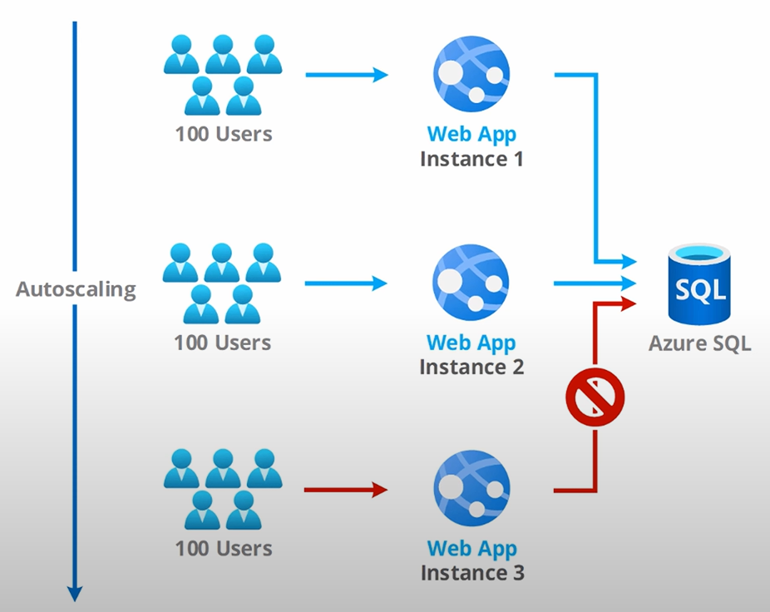
Why the need for queues ?
If autoscaling is enabled in our Azure App Service / Azure Kubernetes cluster, all instances will contest for the shared resource (Azure SQL Server in this case).
This can cause database locks, contentions and timeouts which can lead to potential loss of data.

Slide 3
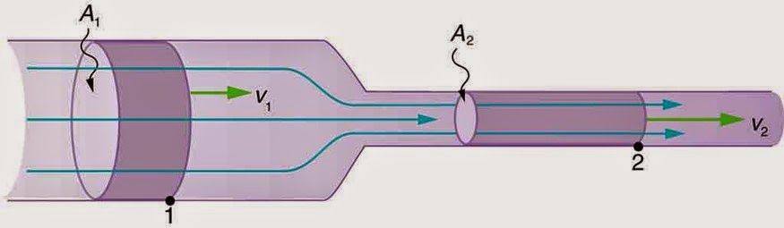
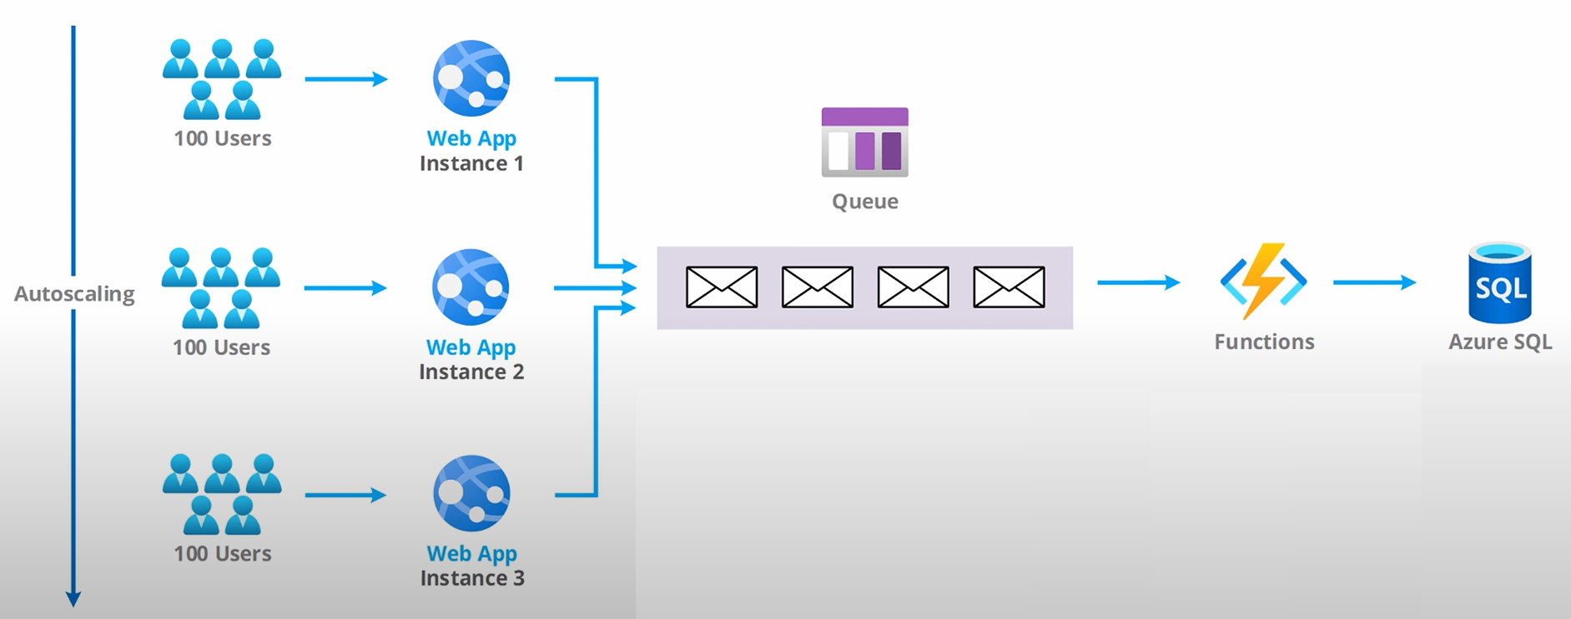
Queue based load levelling pattern
Producer instances can generate traffic to the shared instance at variable loads.
But it will be flattened out in using the queue.
While fetching the consumer can do so in a steady pace so that the shared resource can keep up.

Slide 4
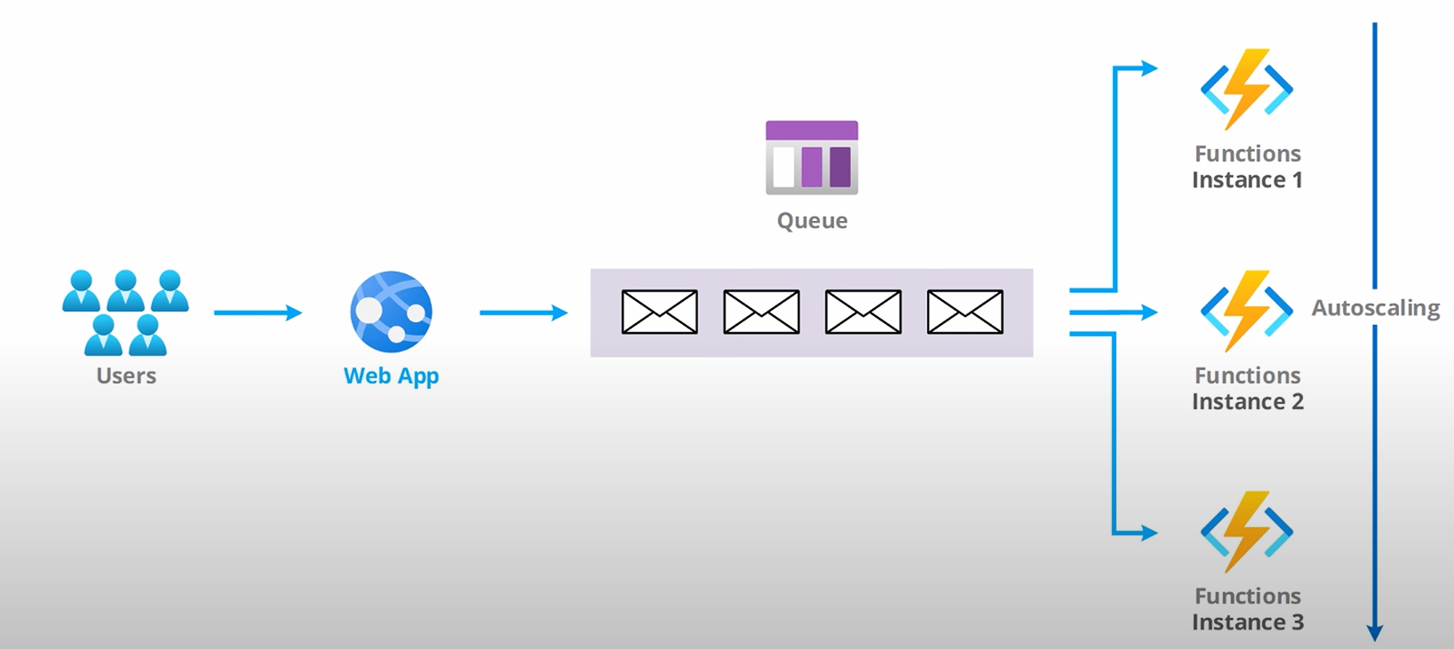
Competing consumer pattern
Consumers can have auto-scaling enabled and process messages from the queue in parallel which can give more throughput.

Slide 5
Popular Messaging Solutions
MSMQ (Queues hosted in Windows) – Microsoft – On Premise/Legacy
Redis (Pub-Sub model) – RedisLabs – OnPremise/SaaS
RabbitMq (AMQP based open-source message broker) – VMware/Pivotal – On Premise/Managed
Kafka (Binary over TCP based open-source message broker) – Confluent – On Premise/Managed
Azure Storage Queue (Sub service in Azure Storage container) – Microsoft – SaaS
Azure Service Bus (Enterprise level AMQP based messaging system having both queue and topic capabilities) – Microsoft – SaaS
Azure Event Grid (Enterprise queueing solution to listen to Azure generated events) – Microsoft – SaaS
AWS SQS (Simple queue service providing polling API to fetch messages) – Amazon – SaaS
AWS SNS (Simple notification service providing pub-sub capabilities) – Amazon - SaaS

Slide 6
Message Delivery Semantics
Any messaging solution can guarantee one of the following message delivery guarantee.
At most once – Messages may be lost in transit but are never redelivered.
At least once - Messages are never lost and may be redelivered.
Exactly once – Each message is delivered once and only once.

Slide 7
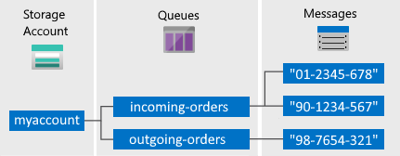
Azure Storage Queue
Fully managed queuing solution provided by Azure as a sub-service under Azure Storage account service.
Storage account sits on top of the hierarchy.
An Azure Storage queue lives under the Azure storage account.
A single storage account can have unlimited queues.
A single queue can grow up to 500 TB.

Slide 8
The maximum message payload size is 64KiB and 48 KiB with Base64 encoding.
6 types of redundancy supported with 99.99% SLAs ranging from 11 9s to 16 9s.
Max throughput of 20000 (1 KiB) messages/sec on the Storage account level and 2000 (1 KiB) messages/sec on the queue level and exceeding those limits can cause HTTP 429 or HTTP 503.
At least once message delivery guarantee.
Messages can come in any order and will not be FIFO guaranteed.
We can peek messages without having to lock the message.
Only poll style API is supported (i.e., consumer application need to poll the queue for incoming messages).

Slide 9
Messages can have infinite TTL, or we can configure TTL on per message basis.
Only 1 receive mode supported – Peek and Lease which is at individual message level.
The default lease duration(Visibility timeout) is 30 seconds, which can go up to 7 days maximum.
In place updating of message is supported.
De-duplication is not present in Azure Storage queues.
In built dead letter queue(DLQ) support is not there, so we need to create Poison queue manually.
No transactions support.

Slide 10
Available SDK(s) in a variety of languages (C#, Node.js, Java, PHP, C++, Rest API)
For .NET based applications, the consumer can be ranging from simple console applications / .NET core Background Services / Azure Functions.
Available authorization methods –
Account key (Admin access on the storage account)
Shared Access Signature (SAS)
Azure AD with RBAC roles.
Naming conventions for Azure Storage queue –
Only lowercase letters allowed.
Queue name must be between 3-63 characters long.
Queue name may only contain letters, numbers and hyphens and no special characters.

Slide 11
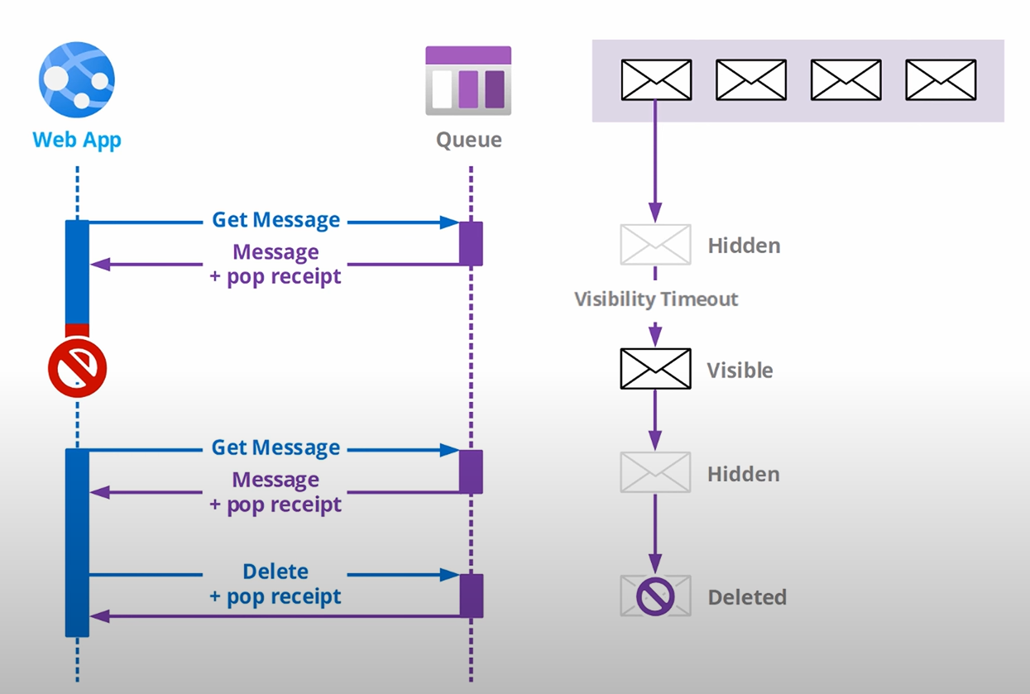
Message Retrieval Process in Azure Storage Queue
Step 1) Receive message from the queue (Non-destructive)
Step 2) Lease is acquired as per visibility timeout specified at consumer side.
Step 3) Current message becomes invisible to other consumers.
Step 3a) If the visibility timeout expires the message is requeued back for other consumers to process.
Step 4) Process the message
Step 5) Delete the message from queue using the message’s messageId and pop-receipt.

Slide 12
Azure Storage Queue Replication
Azure Storage Queue supports 6 replication levels with SLA ranging from 99.99999999999% (11 9s) to 99.9999999999999999% (16 9s) availability of your data.
Locally-redundant storage (LRS) – Least expensive
Zone-redundant storage (ZRS)
Geo-redundant storage (GRS)
Read-access geo-redundant storage (RA-GRS)
Geo-zone-redundant storage (GZRS)
Read-access geo-zone-redundant storage (RA-GZRS) – Most Expensive

Slide 13
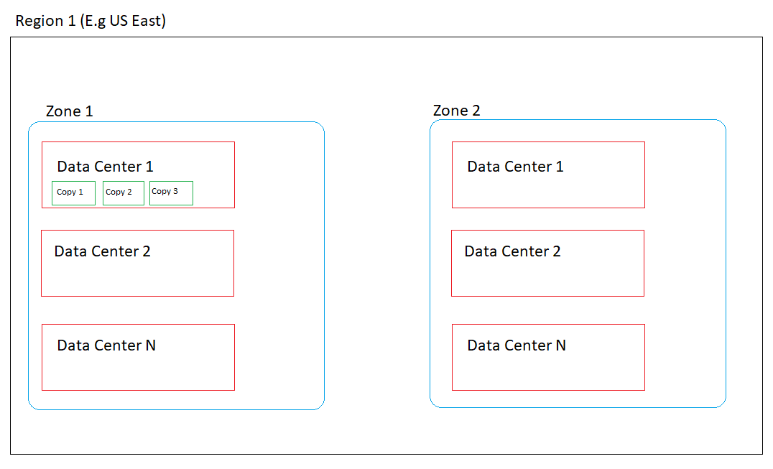
Locally-redundant storage (LRS)
Lowest cost replication option.
99.99999999999% (11 9s) SLA provided.
3 copies of data saved synchronously in a single data center (DC)
If DC downs, data is lost/irrecoverable.

Slide 14
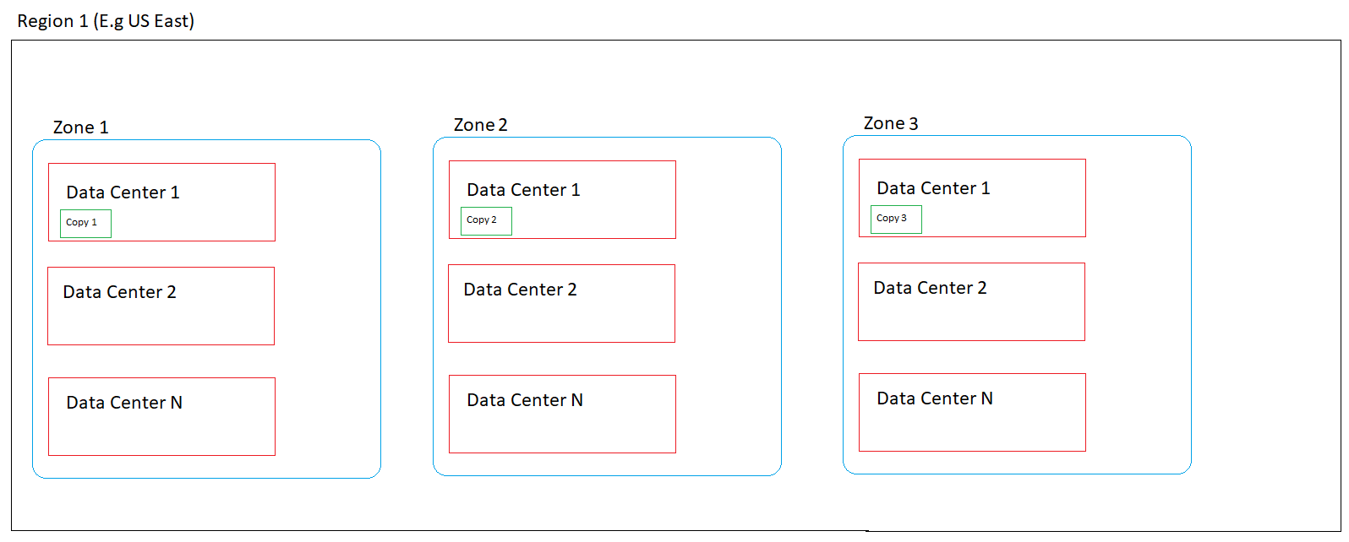
Zone-redundant storage (ZRS)
Microsoft recommends ZRS.
99.999999999999% (12 9s) SLA provided.
3 copies of data saved synchronously, 1 copy in each zone.
If DC down or Zone down data is still recoverable.
Not fool-proof as prone to regional disaster.
Data flow is synchronous because zones in a region are connected using very high-speed internet.

Slide 15
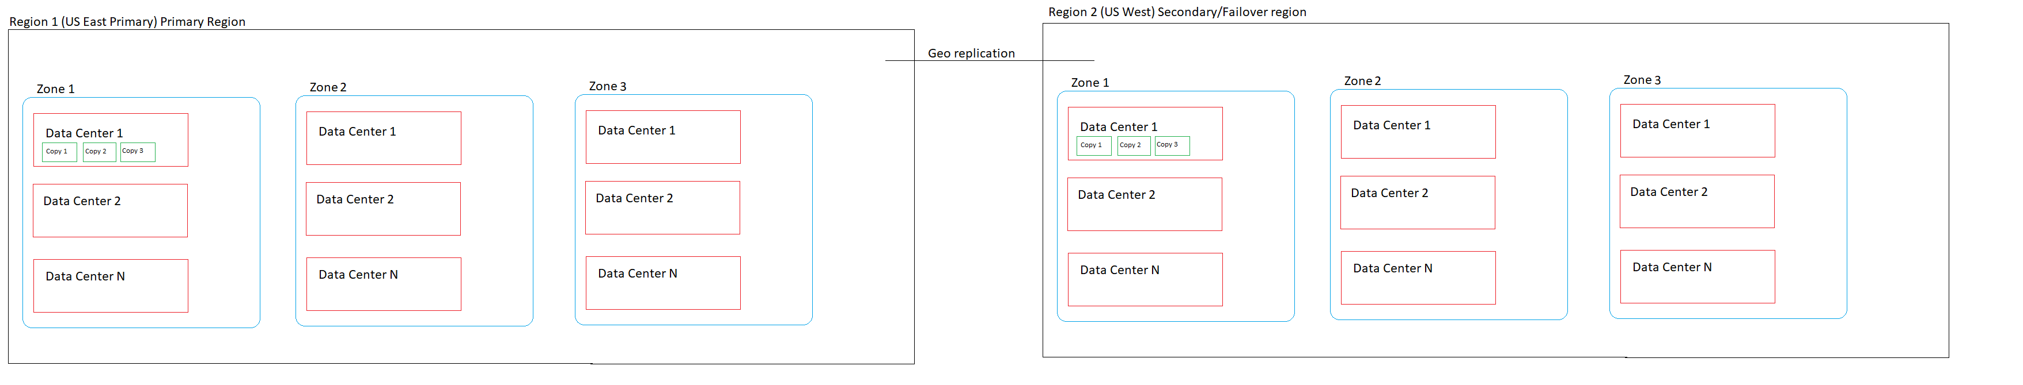
Geo-redundant storage (GRS)
3 Copies like LRS in a single region and 3 copies in another region.
Up to 99.99999999999999% (16 9’s) SLA.
Within the same region the replication is synchronous and within different regions it is asynchronous.
Can’t access data in secondary region unless there’s a failover.

Slide 16
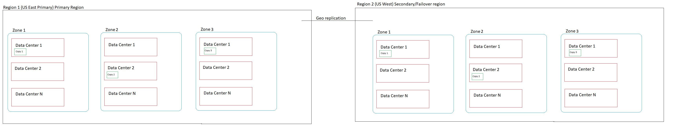
Geo-zone-redundant storage (GZRS)
3 Copies like LRS in a single region within different zones and 3 copies in another region.
Up to 99.99999999999999% (16 9’s) SLA.
Within the same region the replication is synchronous and within different regions it is asynchronous.
Can’t access data in secondary region unless there’s a failover.

Slide 17
Read-access geo-redundant storage (RA-GRS)
Basically, is just GRS with read-access.
Capability of read access in Secondary region without the need of failover.
When doing failover the secondary which is becoming primary can be up to 15 minutes behind based on Last Sync time value (UTC).

Slide 18
Read-access geo-zone-redundant storage (RA-GZRS)
Same as GZRS with capability of providing read access in multiple zones in the secondary region.

Slide 19
Azure Storage Queue Encryption
Data at rest is encrypted using AES-256 symmetric key algorithm which is FIPS 140-2 compliant.
We can doubly encrypt our data by using –
Microsoft managed keys
Customer managed keys (DIY)
No additional cost is associated for encryption.

Slide 20
Azure Storage Queue Pricing
Interactive pricing calculator for different azure regions can be viewed here.

Slide 21
Azure Storage Queue C# SDK
Microsoft recommends Azure Queue Storage client library v12 for .NET
Install-Package Azure.Storage.Queues -Version 12.0.0
Register the QueueClient as Singleton lifetime in .NET Core IoC container.
Client methods are thread-safe.
Some of the important client methods are –
SendMessageAsync – Send (Enqueue) a single message to queue with optional visibility timeout and TTL
ReceiveMessageAsync – Receive a single message from the queue with optional visibility timeout
PeekMessageAsync – Peek a single message from the queue without taking a lease.
UpdateMessageAsync – Update a single message in the queue taking input the messageId, popReciept and the visibility timeout.
DeleteMessageAsync – Delete(Dequeue) message from the queue taking input the messageId, popReciept of the message.

Slide 22
Azure Storage Explorer
Electron.js based desktop tool to visualize queue, peek queue messages and perform admin operations on it.
Download it here.

Slide 23
Demo

